Slide 1


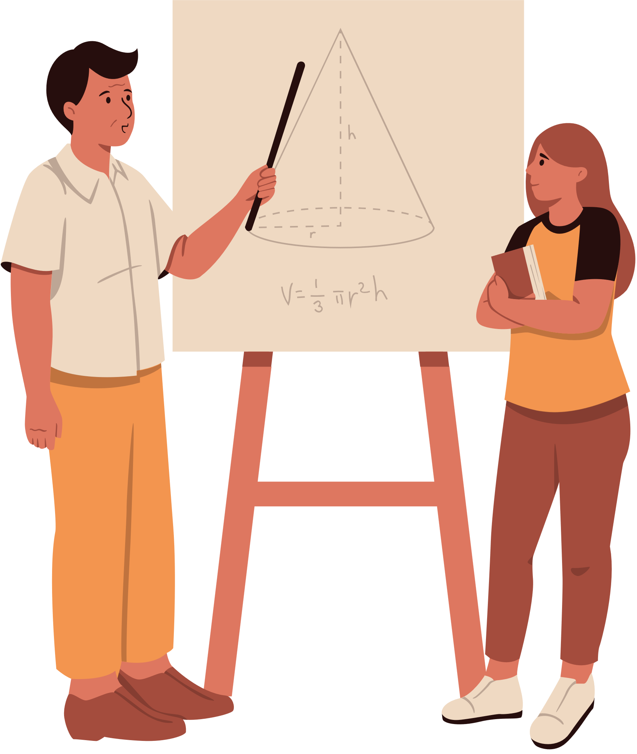

DATA VISUALIZATION IN EDUCATION & TEACHING
Nisha Vashi, PSYC 6135
April 3, 2025

Slide 2



agenda
Importance of data visualization in education and teaching
Examples in various academic fields
Recommendations

Slide 3



Human brain processes visuals 60,000 times faster than text
Eyes can register 36,000 visual messages per hour
90% of the information transmitted to the brain is visual
Approximately 60% of the population are visual learners
40% of all nerve fibres connected to the brain are linked to the retina
Mylavarapu, 2016
Notes:
In his cognitive theory of multimedia learning, Mayer (2014, p. 1) states that "people learn more deeply from words and pictures than from words alone."

Slide 4
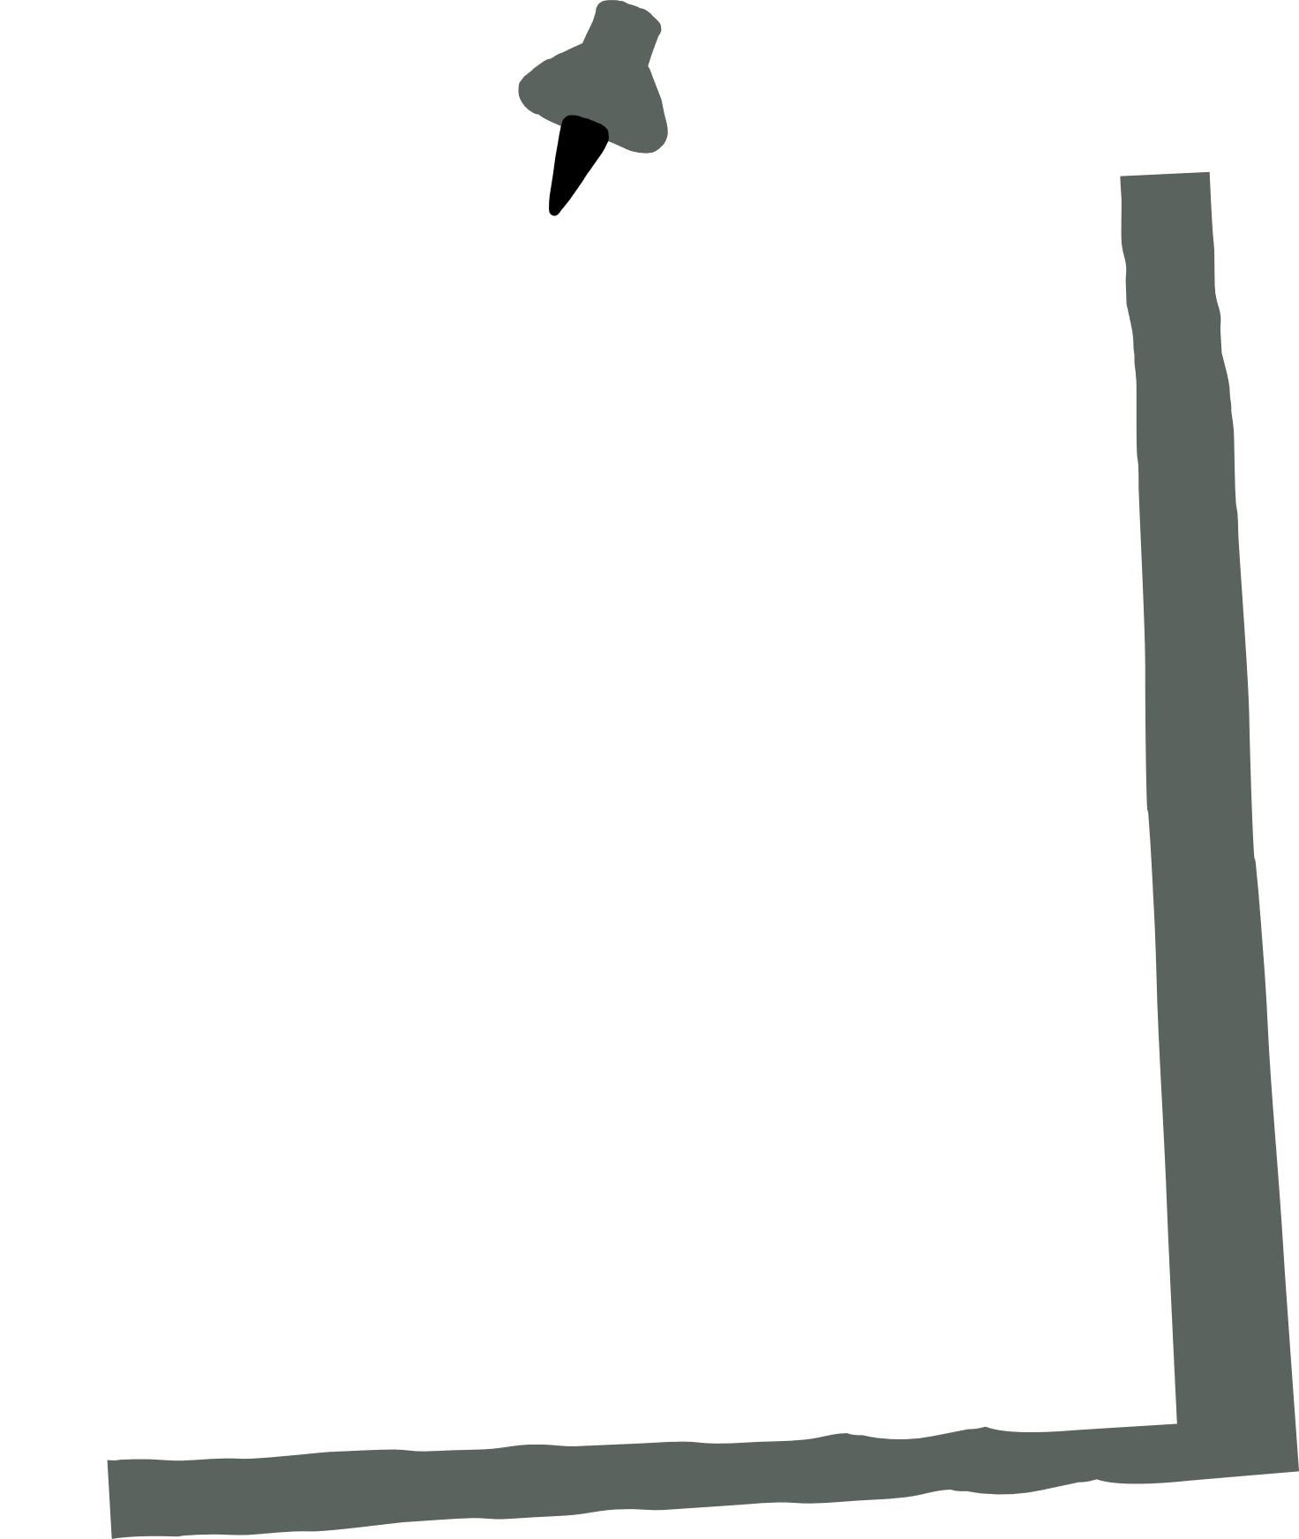


1) Simplifies complex information
2) Engagement
3) Supporting personalized learning
4) Facilitating collaborative learning
5) Improving critical thinking skills
Why is data visualization particularly important in the teaching and education field?
Notes:
Simplifying Complex Information
- Data visualization allows for the simplification of challenging subjects like mathematics
Engagement
Visual content is inherently more engaging than textual data. By incorporating data visualization into lessons, educators can capture students' attention, making learning more interactive.
Supporting Personalized Learning
- With data visualization, educators can customize lessons to suit individual learning needs
Facilitating Collaborative Learning
Many data visualization platforms allow for real-time collaboration. Tools such as Google Data Studio let students and teachers work on the same data project simultaneously, encouraging teamwork and collective problem-solving.
Improving Critical Thinking Skills
Data visualization enhances critical thinking by allowing students to see trends and patterns that may not be obvious in raw data, fostering an analytical mindset.

Slide 5
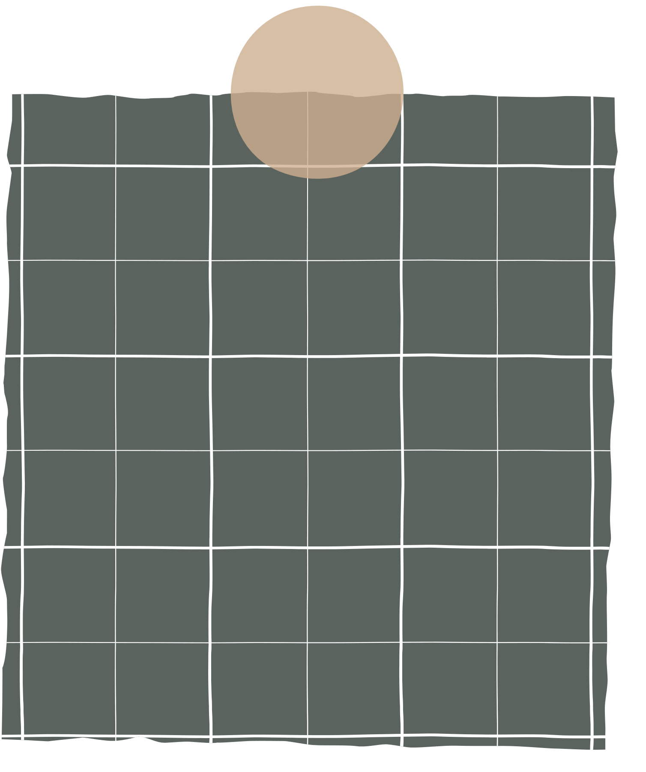

data visualization
Emerging fields such as learning analytics (LA) and human-computer interaction (HCI) focus on the potential for data visualizations, dashboards, and new representations of learning data to drive the instructional improvement process (Alhadad, 2018; Datnow et al., 2012; Wardrip & Herman, 2018)
Bhavimane et al. (2024) ⟶ comprehensive reivew of the impact of data visualization in teaching
a) Effectiveness of visual tools in engaging students
b) Increased comprehension
c) Skill development
c) Interactive learning environment
Notes:
- Bhavimane et al. (2024) completed a comprehensive review of the impact of data visualization in teaching
- Review highlighted that students showed increased interest and active participation when using interactive visualization tools (Guo et al., 2014)
- Improved understanding: Visual tools helped students grasp concepts more easily (Kozma & Russell, 1997)
- Skill development: Students developed critical thinking, data analysis, and interpretation skills (Johnson et al., 2015)
- Interactive learning: Hands-on, exploratory nature of data visualization tools fostered a more interactive learning environment (Shneiderman, 1996)

Slide 6
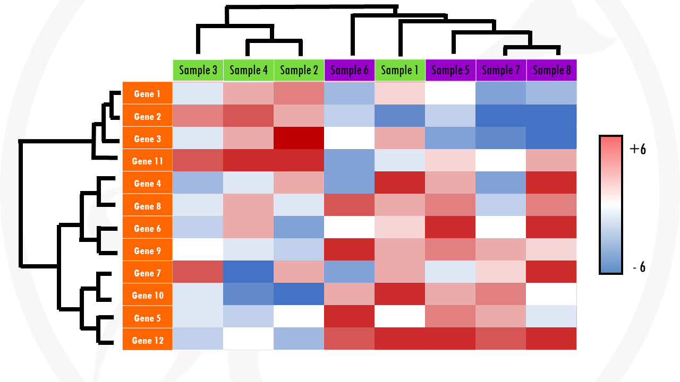
BioStatSQUID, 2025
Notes:
- In the field of biology, heat maps can be used to quantify gene expression across various samples
- In this type of heatmap, each row usually represents a gene. Each column represents a sample.
- Represent changes (not absolute values) of gene expression. Red would mean that a gene is upregulated in the sample, and blue would mean that a gene is downregulated
- If a gene does not change much between conditions (so it’s differential gene expression is close to 0), we will just give it a white colour.
- This way, we can quickly identify samples that are more similar to each other based on their overall gene expression patterns. And we can also identify genes that have the same expression profile across all, or a certain subset of samples.

Slide 7
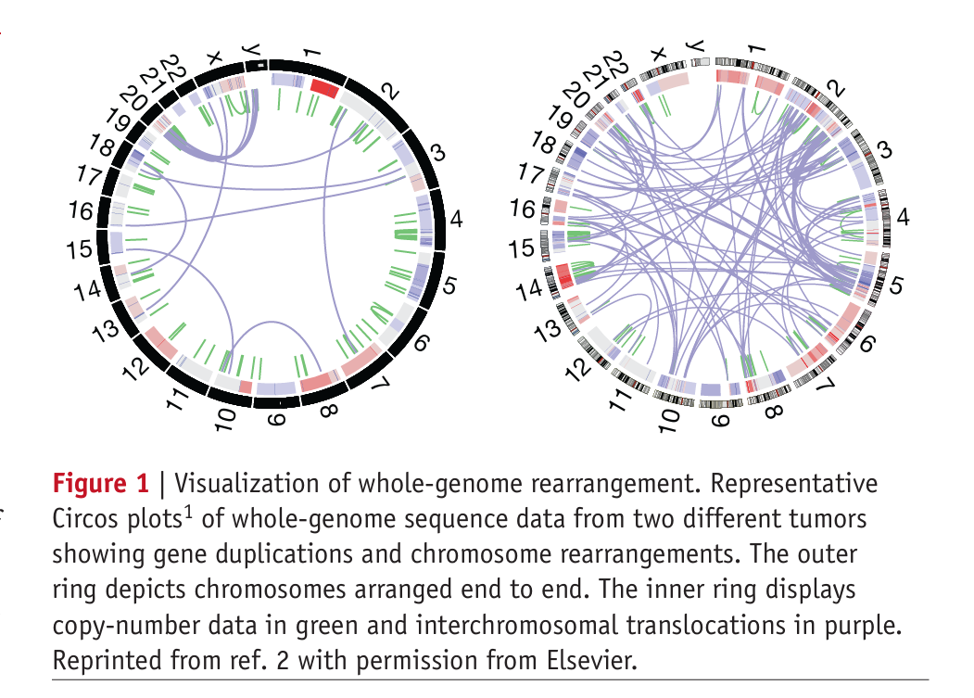
Wong, 2012
Notes:
- Circos plots are circular data visualizations that excel at showcasing relationships between data points, particularly in genomic data, by using links to represent connections between elements
- In this example, there are two plots showing genome sequence data from two different tumours
- The outer ring depicts the chromosome numbers arranged from end to end
- Inner ring displays copy-number data (number of copies of specific DNA sequences) in green and interchromosomal translocations in purple (where segments of genetic material are exchanged or moved between different chromosomes)

Slide 8
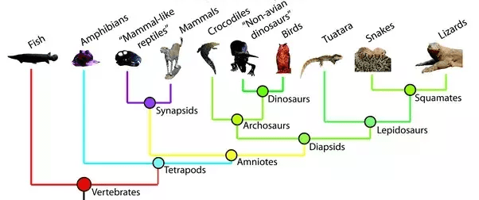
Organismal Biology, 2025
Notes:
- Finally, a phylogenetic tree, also known as a phylogeny or evolutionary tree, is a branching diagram that illustrates the evolutionary relationships between different species, organisms, or genes, showing how they are related through a common ancestor
- Tips of branches: Represent the species or groups being studied.
- Nodes (branch points): Represent common ancestors from which different lineages diverged.
- Root: The base of the tree, representing the common ancestor of all the species or groups shown.
- can be created through ggtree in R

Slide 9
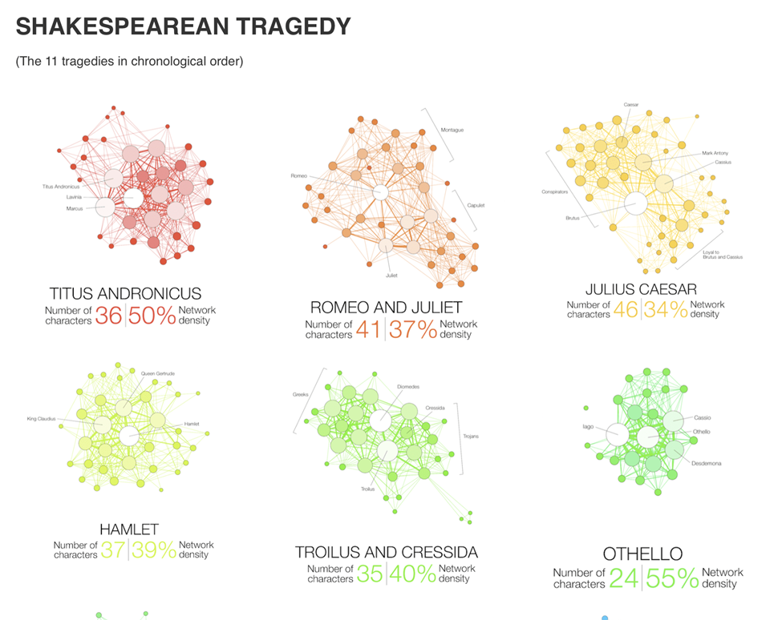
Martin Grandjean, 2015
Notes:
- There are many qualitative data visualization approaches that are common to describing English concepts, such as word clouds and semantic mapping
- Network mapping is a data visualization technique that represents relationships and connections between different entities (nodes) using lines (edges). It is used to analyze and understand complex systems, revealing patterns, clusters, and central influences.
- In this particular visual, we can see the characters that are prominent in different Shakespearean trajedies
- Two characters are connected if they appear in the same scene. Their size and color intensity are proportional to their weighted degree. The ‘network density’ measures how close the graph is to complete. A complete graph (100%) has all possible edges between its nodes.

Slide 10
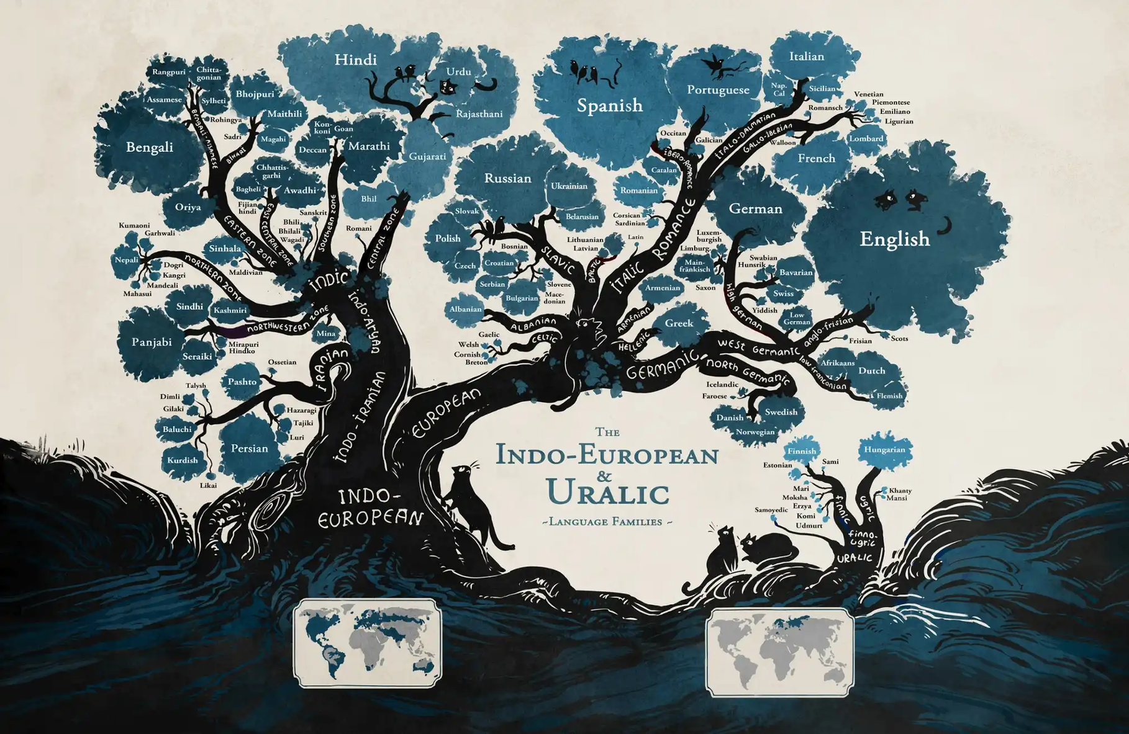
Minna Sundberg, 2015
Notes:
- Here is another visualization used to show the relationships between different language groups
- Linguists have often used trees and branches as metaphors to explain and map the connections between language groups
- For example, we can see that European languages branches into slavic, italic, and germanic languages, resulting in commonly known languages we use today such as Russian, Spanish, and German
- On the left side, Indo-Iranian languages have branched into varios languages we know today, such as Persian, Hindi, and Bengali
- Notably, the size of the different leaf clusters indicates the relative prevalence of the language

Slide 11
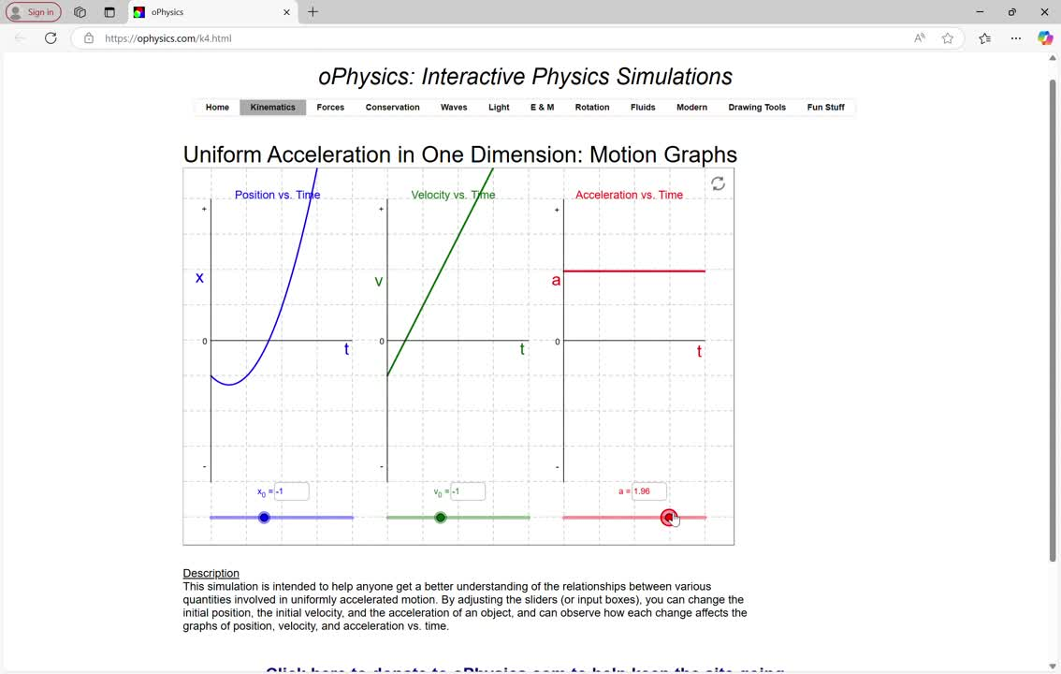
oPhysics: Interactive Physics Simulations, 2025
Notes:
- Another academic field that may benefit from data visualization is physics, because it transforms complex data and abstract theories into clear, intuitive visuals
- Here is one example from oPhysics of an interactive data visualization, which I have screenrecorded here. This motion graph has been used to explain the relationship between position, velocity and acceleration
- As we can see here, because position is a function of velocity, an increase in velocity increases the slope of the curved line in the position graph
- Also, we can see that velocity is influenced by acceleration, as a constant increase in acceleration increases the slope of the line in the velocity graph, or the rate of change in velocity
- So data visualization graphs such as this animated one can help to describe the relationship between different variables that are more abstract to teach

Slide 12
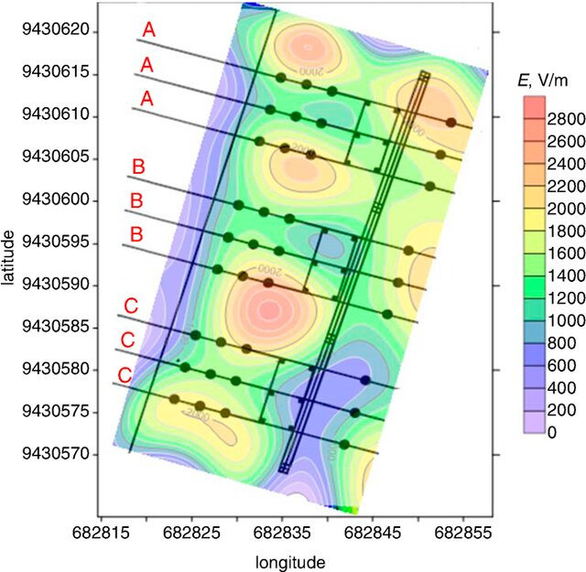
Andrade, 2020
Notes:
- Here is another data visualization technique called a countour map, which is used to depict electric field levels
- As we can see the latitude is on the Y axis, and longitude is on the X ais
- E, V/m refers to the electric field strength, which is measures in Volts per meter, which represents the voltage experienced by a charge moving through a distance of one meter in that field
- In this data visualization, we can see that warmer colours such as red and orange represent stronger electric field strengths, and cooler colours such as violet and blue represent weaker electric field strengths

Slide 13
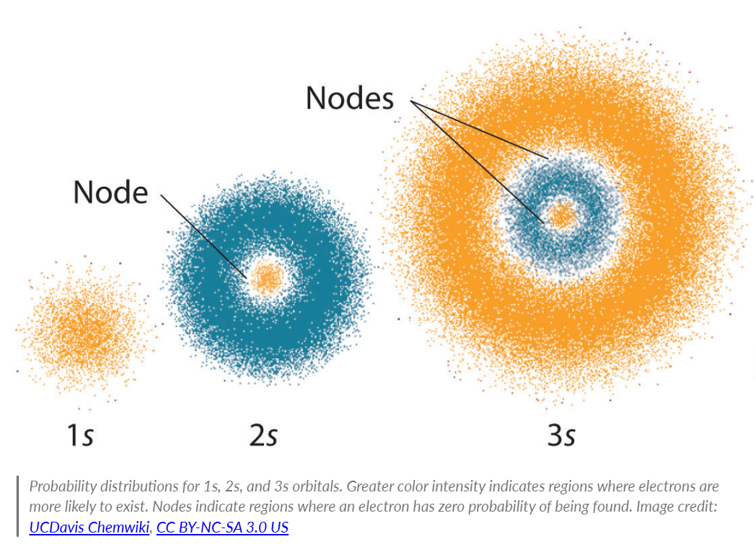
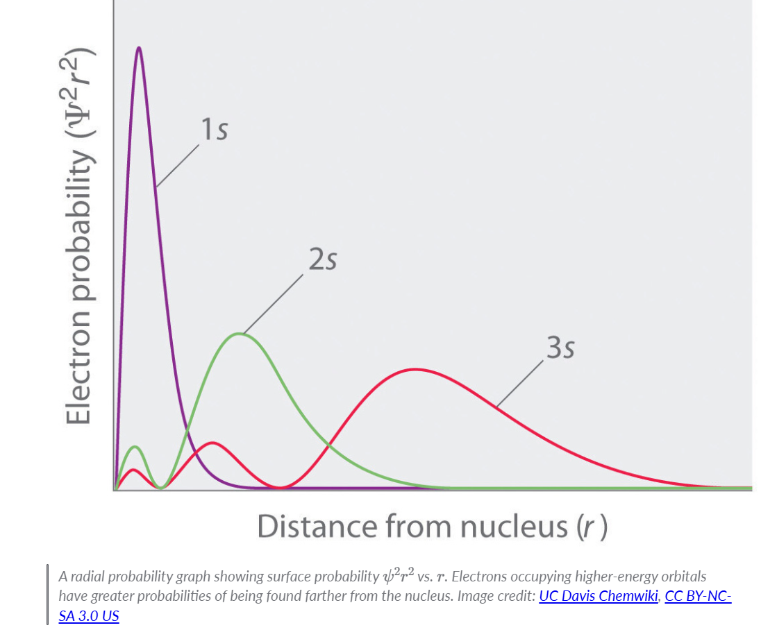
Khan Academy, 2025
Notes:
- Finally, probability density graphs can be used to illustrate physics principles surrounding atomic orbitals
- For example, the visual on the left indicates atoms with different orbitals. A density graph is used to provide a visual representation of where an electron is most likely to be found around a nucleus
- On the graph on the right, we can see that for the 1s orbital, the electron is more likely to be found closed to the nucleus, followed by 2s, followed by 3s

Slide 14
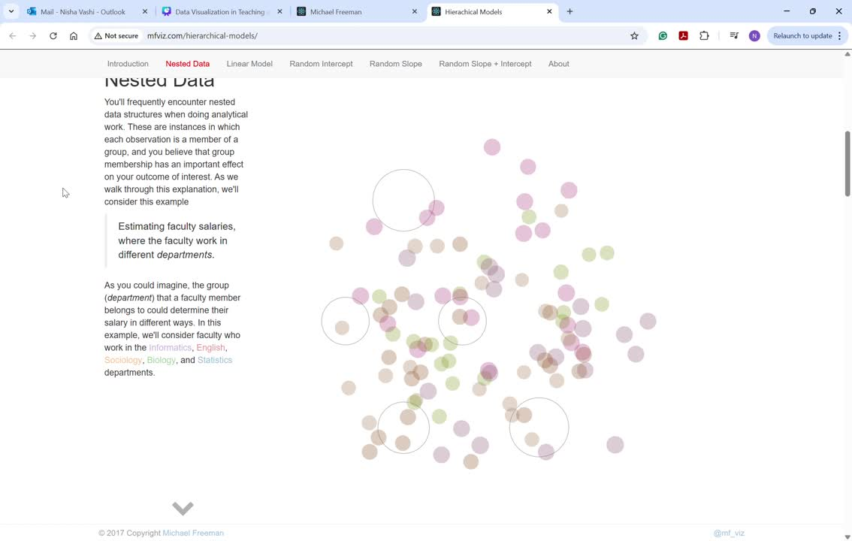
Michael Freeman, 2017
Notes:
- This visual explanation introduces the statistical concept of Hierarchical Modeling for nested data
- For this example, they looked at different faculty salaries across various departments, including Informatics, English, Sociology, Biology, and Statistics, represented by the different colours
- In a simple linear approach, we might be able to estimate faculty salaries based on the number of years of experience.
- However, it may be the case that each department has a different starting salary for their faculty members. For this, we would want to allow the intercept to vary by group.
- Alternatively, we could imagine that faculty salaries increase at different rates depending on the department. We could incorporate this idea into a statistical model by allowing the slope to vary, rather than the intercept.
- It's reasonable to imagine that the most realistic situation is a combination of the scenarios described above: faculty salaries start at different levels and increase at different rates depending on their department.

Slide 15
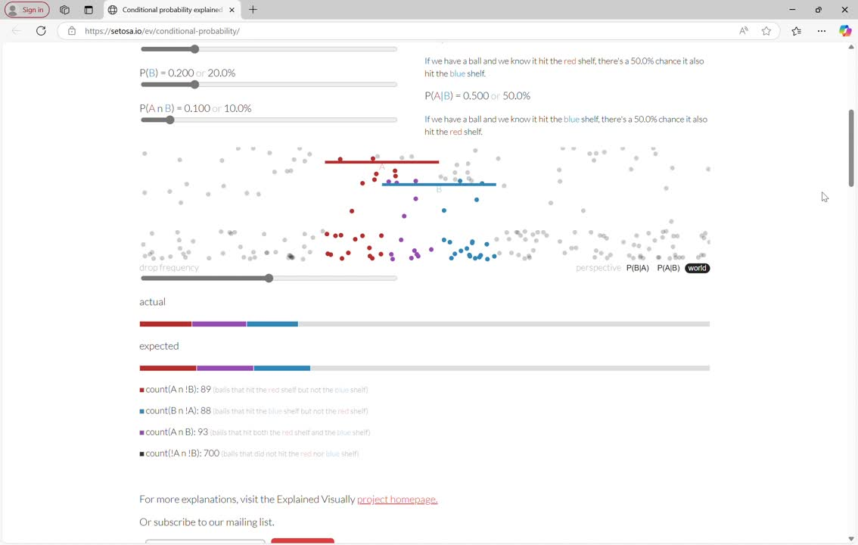
Victor Powell, 2025
Notes:
- A conditional probability is the probability of an event, given some other event has already occurred. In the below example, there are three possible events that can occur. A ball falling could either hit the red shelf (we'll call this event A) or hit the blue shelf (we'll call this event B) or both.
- If we have a ball and we know it hit the red shelf, there's a 50.0% chance it also hit the blue shelf. If we have a ball and we know it hit the blue shelf, there's a 50.0% chance it also hit the red shelf. It's also possible that the ball only hits the red shelf, or only the blue shelf. This is the essence of conditional probability.
- Having a visualization like this helps learners picture and understand the likelihood of one event occuring given whether another event has occured or not

Slide 16
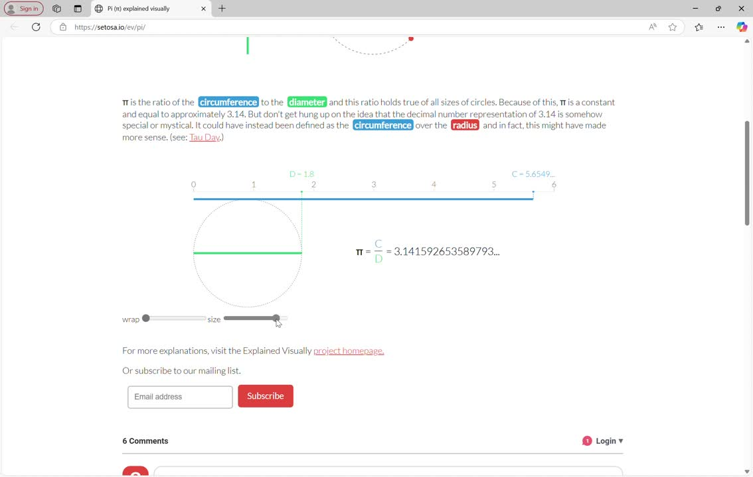
Victor Powell, 2025
Notes:
- Finally, data visualizations can be used in interactive visualizations to describe foundational mathematical concepts such as Pi
- This visualization depicts how Pi is calculated as circumference and diameter changes.
- We can see that regardless of the values we select, pi is a constant and equal to approximately 3.14.

Slide 17


RECOMMENDATIONS
Choose data visualization tools that are user-friendly and align with edcuational objectives
Tools should cater to the needs of subject and students’ proficiency levels
Design lessons that integrate visualization tools to encourage exploration and interaction
Use real-world datasets to make learning relevant and engaging
Regularly assess the impact of data visualizations on student learning outcomes
Bhavimane et al., 2024

Slide 18
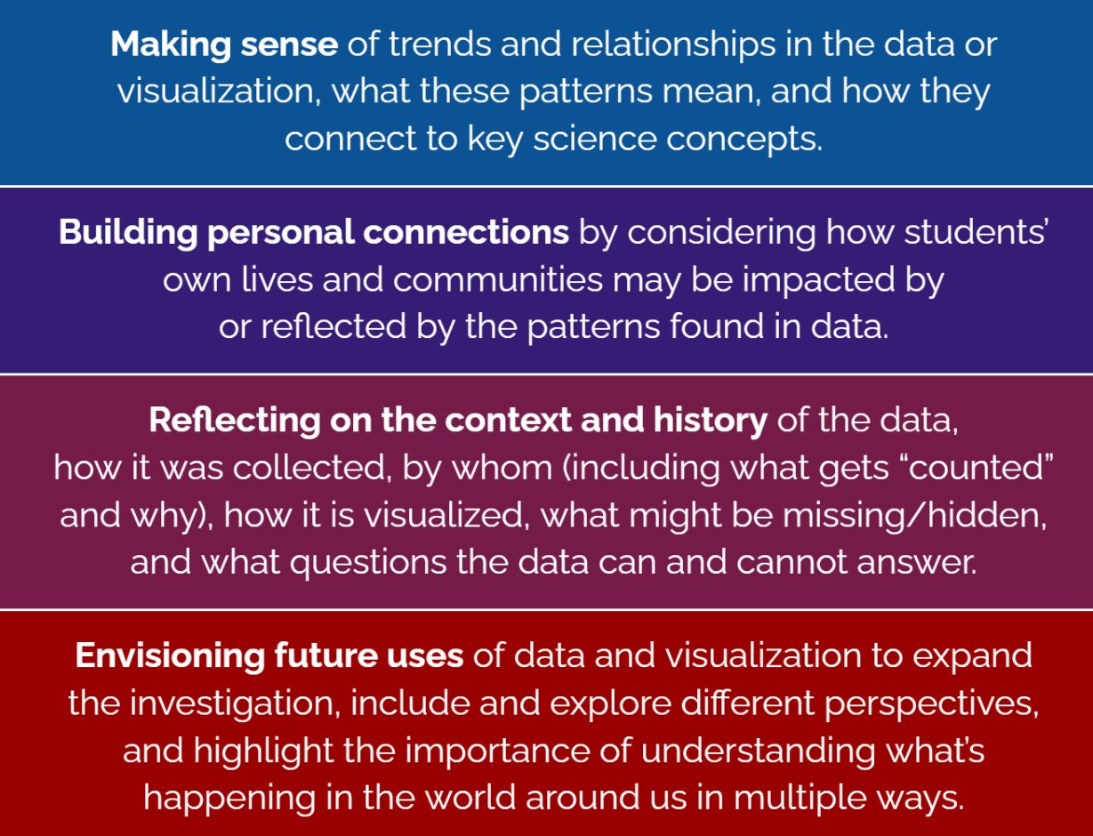
Lee et al., 2022
Notes:
- For the last few minutes of the presentation, I wanted to speak about how we can actually teach other students about how to effectively analyze and interpet data visualizations
- A US-based study in 2022 investigated the efficacy of a data visualization discussion model, called Data Story Byes
- I thought we can go through each of these sections together as a class exercise using the following visual

Slide 19
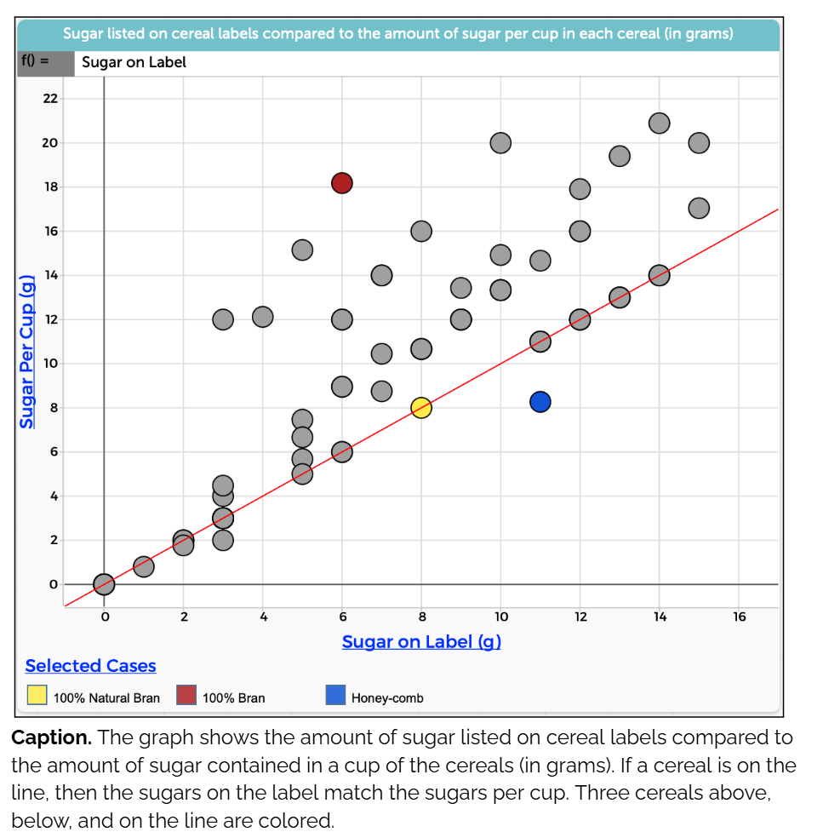
Lee et al., 2022
Notes:
Making Sense
What is the first thing you think about or wonder when you see these graphs?
Potential teacher prompts: What do you think the red line represents? Why do you think most of the cereals (points) are above the line?
What do you notice in the graph?
Potential teacher prompts: What would you say about the “selected cases” cereals based on this graph?
Personal Connections
Do you have a personal connection with the data or patterns in this graph? Why or why not? Which people or groups do you think would feel more or less of a connection with the data or patterns here?
Potential teacher prompts: Do you ever look at cereal labels, or other food labels? What do you look for on the labels?
Does this graph help you understand how diet and nutrition affect you? What other information would you want or need to better understand how diet and nutrition affect you?
Potential teacher prompts: Would you change what you look at on nutrition labels based on what you notice in this graph?
Who do you think made this graph? Why did they collect this information and create this graph? What did they want to know?
Potential teacher prompts: Would cereal companies be likely to look at their nutrition labels this way? How about a nutritionist, or a consumer (or you)? Why or why not?
Context and History
What could you do to this dataset/graph to make it more useful for yourself or others who might not be included here? For example, would you collect more data, group or graph the data differently, take different measurements, or focus on certain parts of the data?
Potential teacher prompts: Do you think one cup of cereal is a good amount to consider? How many cups of cereal do you/would you put in your bowl of cereal? If different from a cup, would that be a better measure? Why or why not?
What are some reasons for the patterns you see? How might these patterns be different if the data had been collected by different people, or in a different time period?
Potential teacher prompts: Do you think the graph would change if cereals did not have nutrition labels? If so, how so?
Future Uses of Data
What are some questions you can use this data or graph to answer? What are some questions this data or graph cannot help answer?
Potential teacher prompts: Does this graph help you choose a cereal, if you could look up the cereal names of each point? Where do you think your favorite cereal is on this graph, if you have one? How about another breakfast food that you eat?
If you had to write an article about diet based on this graph, what would the headline be? What might be missing from that article?
Potential teacher prompts: Do you think that cereal nutrition labels are misleading? Should there be a standard serving size for cereals, or other foods?
What else does this activity make you want to know about?
Potential teacher prompts: Why do foods have nutrition labels? Should the sugar amount on
nutrition labels also have a percent daily value, like other nutrients?

Slide 20

ANY QUESTIONS?

Slide 21
REFERENCES
Alhadad, S. S. (2018). Visualizing data to support judgement, inference, and decision making in learning analytics: Insights from cognitive psychology and visualization science. Journal of Learning Analytics, 5(2), 60–85. https://doi.org/10.18608/jla.2018.52.5
de Andrade, H.D., de Figuêiredo, A.L., Fialho, B.R., da S. Paiva, J.L., Queiroz Júnior, I.d.S. & Sousa, M.E.T. (2020). Analysis and development of an electromagnetic exposure map based in spatial interpolation. Electronics Letters, 56(6) 373-375. https://doi.org/10.1049/el.2019.3854
Bhavimane, A., Shetty, R., Kurunji, G. V., Tayenjam, A., & Pushparani, M. K. (2024). Data visualization in education: A comprehensive review. International Journal of Advanced Research in Science, Communication and Technology. 503-509. https://doi.org/10.48175/IJARSCT-18676
BioStatSQUID (2025). Heatmaps for gene expression analysis – simple explanation with an example. https://biostatsquid.com/heatmaps-simply-explained/
Datnow, A., Park, V., & Kennedy-Lewis, B. (2012). High school teachers’ use of data to inform instruction. Journal of Education for Students Placed at Risk, 17(4), 247–265. https://doi.org/10.1080/10824669.2012.718944
Freeman, M. (2017). An introduction to hierarchical modeling. http://mfviz.com/hierarchical-models/
Grandjean, M. (2015). Network visualization: mapping Shakespeare’s tragedies. https://www.martingrandjean.ch/network-visualization-shakespeare/
Khan Academy (2025). The quantum mechanical model of the atom. https://www.khanacademy.org/science/physical-chemistry-essentials/x98cdf762ed888601:structure-of-atom/x98cdf762ed888601:quantum-mechanical-model-of-hydrogen-atom/a/the-quantum-mechanical-model-of-the-atom
Lee, H. S., Mojica, G. F., Thrasher, E. P., & Baumgartner, P. (2022). Investigating data like a data scientist: Key practices and processes. Statistics Education Research Journal, 21(2). https://doi.org/10.52041/serj.v21i2.41
Mylavarapu L., (2016). The power visualization adds to e-learning. https://blog.commlabindia.com/elearning-design/power-of-visualization-in-elearning
oPhysics: Interactive Physics Simulations (2025). Uniform acceleration in one dimension: Motion graphs. https://ophysics.com/k4.html
Organismal Biology (2025). Phylogenetic trees and geologic time. https://organismalbio.biosci.gatech.edu/biodiversity/phylogenetic-trees/
Powell, V. (2025). Conditional probability. https://setosa.io/ev/conditional-probability/
Powell, V. (2025). Pi (π). https://setosa.io/ev/pi/
Sundberg, M. (2015). A language family tree - in pictures. https://www.theguardian.com/education/gallery/2015/jan/23/a-language-family-tree-in-pictures
Wardrip, P. S., & Herman, P. (2018). “We’re keeping on top of the students”: Making sense of test data with more informal data in a grade-level instructional team. Teacher Development, 22(1), 31–50. https://doi.org/10.1080/13664530.2017.1308428
Wong, B. (2012). Visualizing biological data. Nature Methods, 9, 1131. https://doi.org/10.1038/nmeth.2258

